Slide 1
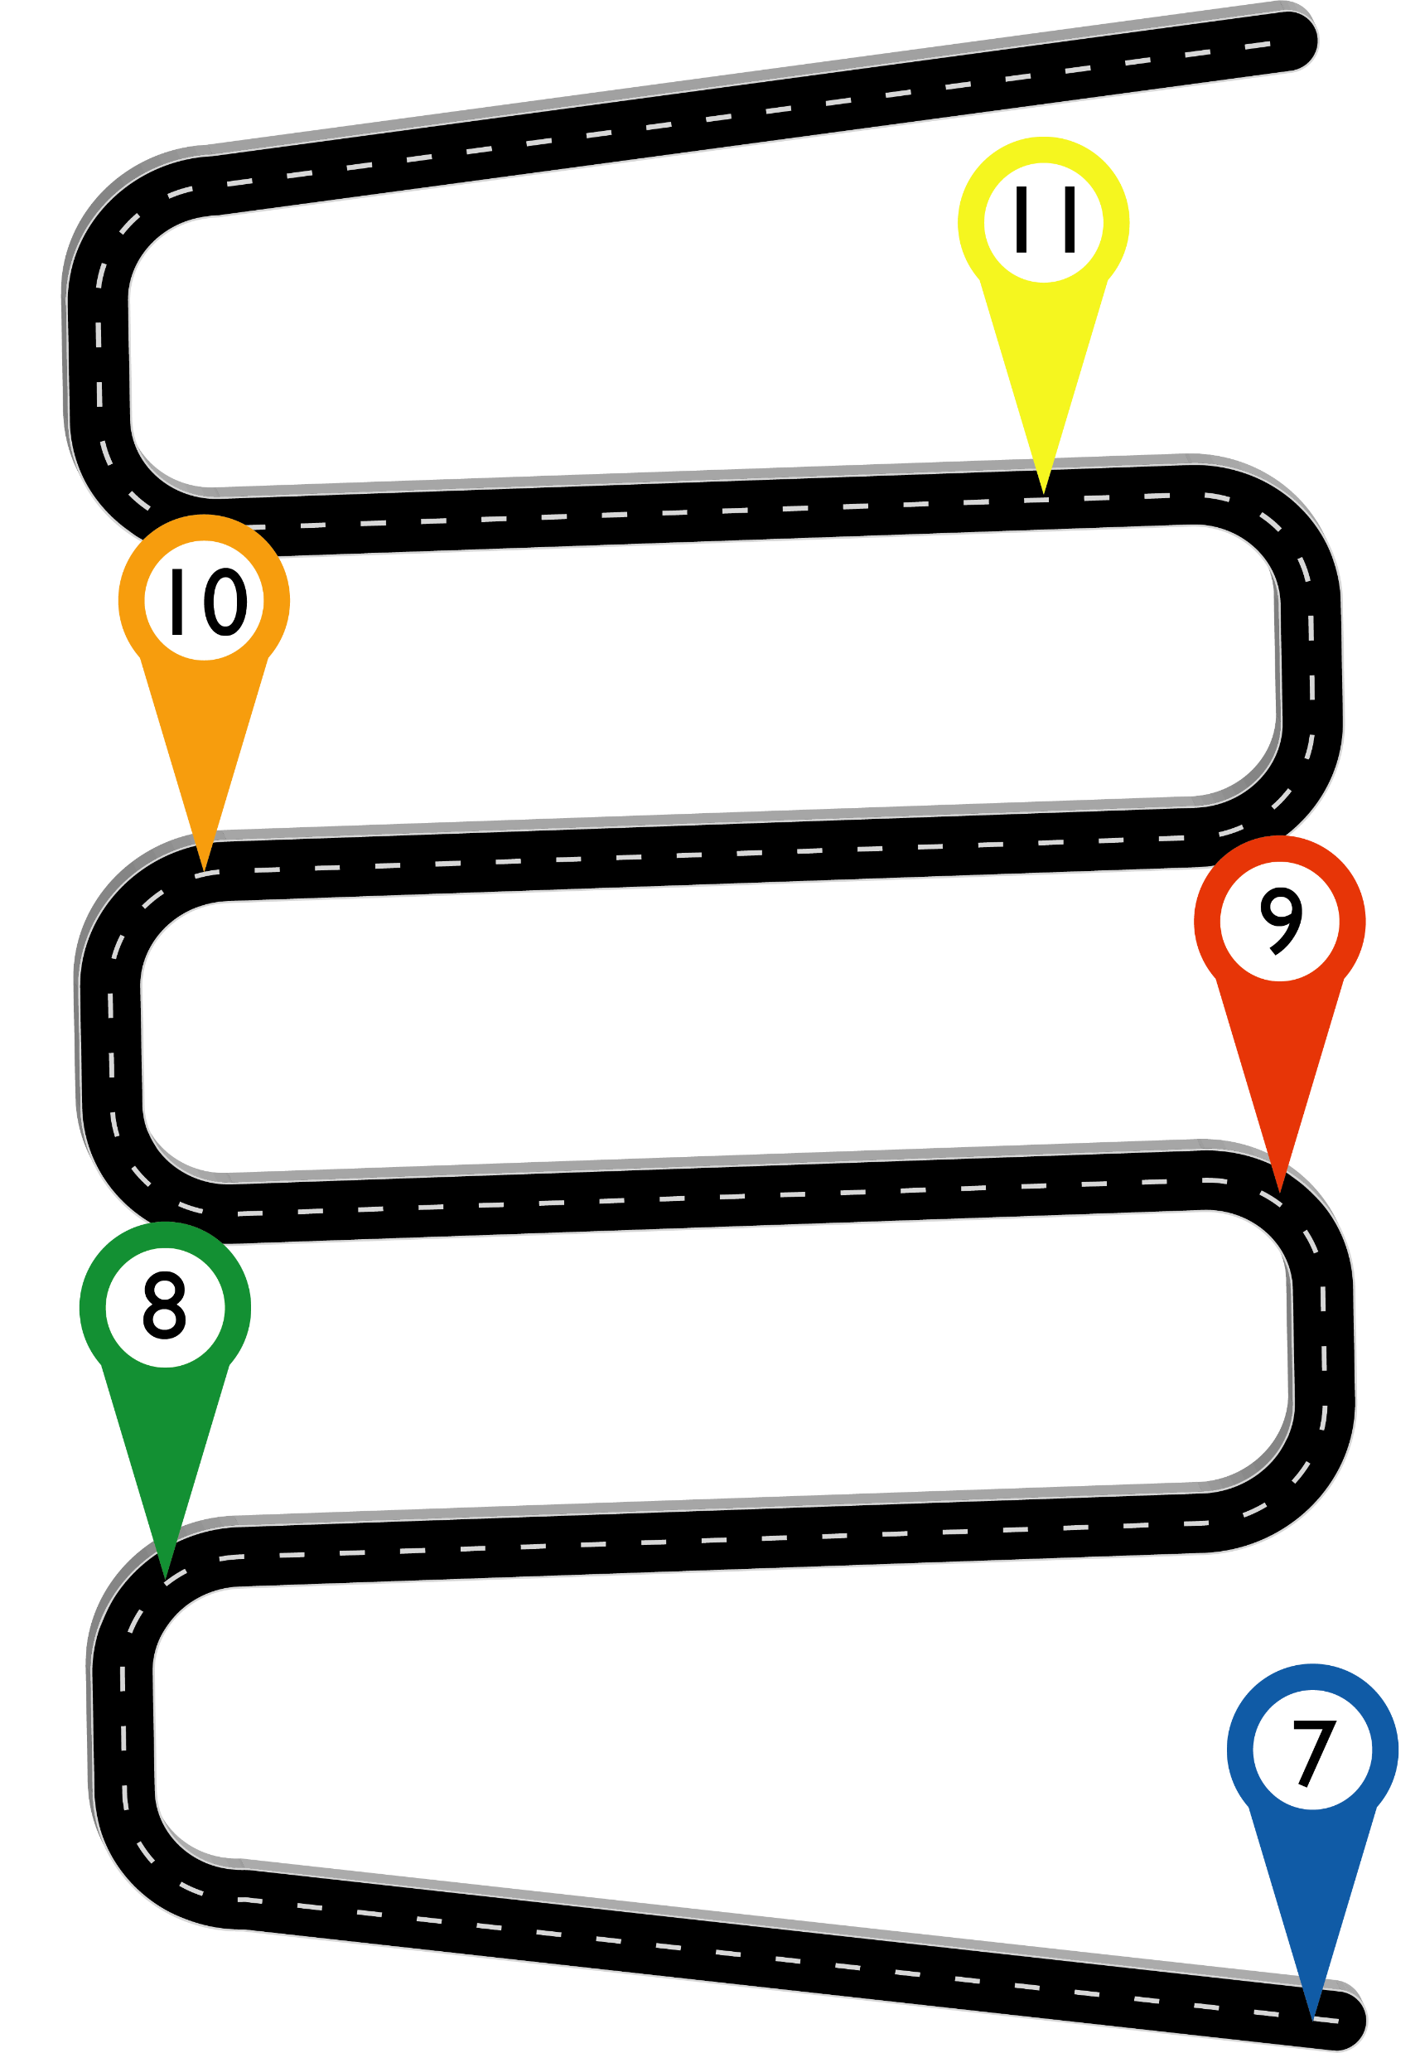



PSHE , Careers & Humanities Road Map
Social Action
Transition- next steps
Communication in relationships
Bringing about change in the legal system
Individual voices in society…make it heard
How has the law developed over time
BYP Vote
Post 16 choices- Career planning Aim Award L1
Mental health and ill health, stigma
UK's role in key international organisations
Healthy relationships
Virtual Work Experiences
human rights and how do we protect them?
media and the free press
Aim Award Environmental Sustainability
British Youth Parliament
British Values in society
Careers & employers, looking and experiencing the world of work
Identity in the UK
Safeguarding & Student Voice
Aim Award Drug Awareness L1
Health & Wellbeing
Religion in the media
The Middle East
Financial Wellbeing
World War One
Peer Influence, Substance use, gangs
Employability Skills
Religion+Ethics
Respectful relationships
Urban issues & Challenges
World War Two
Health and Wellbeing
Peer influence & Gangs
Britain & Slave Trade
Relationships & Healthy Lifestyle
Climate Change
Employability Skills
God
Drugs & Alcohol
17c England
Health & Wellbeing
Living in the wider world
Can we ever know enough about natural hazards to live safely?
British Values
Religion, Peace and Conflict
Financial decision making
Life after death
Health & Puberty
Settlements and Spheres
Developing Skills & Aspirations – BYP Vote
Medieval Monarchs
Building Relationships
Introduction to the three main religions
Diversity
Populations and Settlements
Safeguarding & Student Voice
Norman Conquest

