Slide 1
Where it all started…
The history of the Bicycle

Slide 2
Bicycles – what wonderful machines!
It’s hard to imagine life now without bicycles, but go back just 200 years and there was no such thing!
What questions do you want answered about the history of bicycles?
Let’s start at the very beginning, with the invention of a Walking Machine…

Slide 3
History of Bicycles
It all began in 1817…
German born Baron Karl von Drais invented a walking/running machine to help him get around royal gardens faster. It had…
2 same-size in-line wheels, the front one steerable, mounted in a frame which you straddled.
Von Drais’s idea was an instant success, but soon ridiculed and too expensive for most people. Von Drais died a pauper in 1851.
What is a pauper?
Notes:
The Walking Machine
In 1817 Baron von Drais invented a walking machine that would help him get around royal gardens faster: two same-size in-line wheels, the front one steerable, mounted in a frame which you straddled. The device was propelled by pushing your feet against the ground, thus rolling yourself and the device forward in a sort of gliding walk. The machine became known as the Draisienne or hobby horse. It was made entirely of wood. This enjoyed a short lived popularity as a fad, not being practical for transportation in any other place than a well maintained pathway such as in a park or garden.
Hated by his fellow aristocrats for his democratic leanings, he was ruined by various intrigues. Drais went to Brazil for a few years before returning to his native Germany. In 1838 he survived an assassination attempt. Because of his support for the revolution, the authorities that had crushed the revolt tried to declare him mentally incompetent. He died impoverished in 1851.
The baron's numerous inventions include a typewriter with 25 keys, the meat grinder, a contraption to record piano music on punched paper, the stenotype machine and a pedal-powered quadricycle. While modern versions of Drais' meat grinder are still in use in countless butcher shops and households today, the invention that made him famous in 1817 is the Laufmaschine (running machine) - the ancestor of the bicycle.
An instant - though short-lived - international success, the running machine became known under various names: Draisine in Germany, velocipede (fast feet) or Draisienne in France, hobby horse or dandy horse in England - an allusion to the fact that the dandy horse's riders were mostly dapper young men with too much money on their hands. On the other side of the Atlantic, American critics viewed this latest proof of European eccentricity with scepticism: Every species of transatlantic nonsense, it would seem, is capable of exciting curiosity, no matter how ridiculous, proclaimed a pundit in the Baltimore Morning Chronicle.

Slide 4
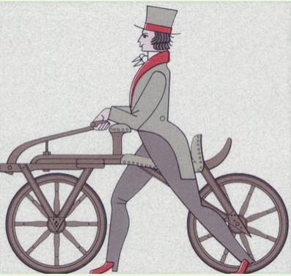
Baron Von Drais’ Walking Machine
The walking machine didn’t remain popular for long! Can you think of reasons why?

Slide 5
1817 1865
The next two-wheeled riding machine included pedals applied directly to the front wheel.
This machine was known as the velocipede ("fast foot"), but was popularly known as the ‘bone shaker,’
Why do you think it earned this nickname?
Notes:
The Velocipede or Boneshaker
The next appearance of a two-wheeled riding machine was in 1865, when pedals were applied directly to the front wheel. This machine was known as the velocipede ("fast foot"), but was popularly known as the bone shaker, since it was also made entirely of wood, then later with metal tires, and the combination of these with the cobblestone roads of the day made for an extremely uncomfortable ride. They also became a fad, and indoor riding academies, similar to roller rinks, could be found in large cities.

Slide 6
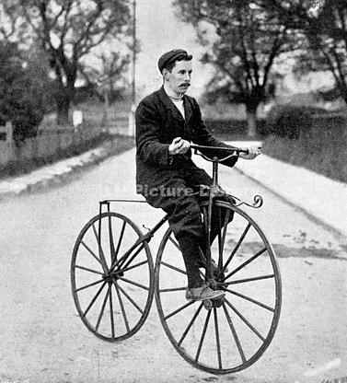
The Velocipede (BoneShaker)

Slide 7
1817 1865 1870
The High Wheel Bicycle, the first all metal machine appeared in 1870.
Rubber tyres and the long spokes of the front wheel meant a smoother ride.
The larger the wheel, the farther you could travel with one push of the pedals.
This was the 1st ‘bicycle’("two wheel").
It cost an average worker six month's pay so were popular with rich young men.
Notes:
In 1870 the first all metal machine appeared. (Previous to this metallurgy was not advanced enough to provide metal which was strong enough to make small, light parts out of.) The pedals were still atttached directly to the front wheel with no freewheeling mechanism. Solid rubber tires and the long spokes of the large front wheel provided a much smoother ride than its predecessor. The front wheels became larger and larger as makers realized that the larger the wheel, the farther you could travel with one rotation of the pedals. You would purchase a wheel as large as your leg length would allow. This machine was the first one to be called a bicycle ("two wheel"). These bicycles enjoyed a great popularity among young men of means (they cost an average worker six month's pay), with the hey-day being the decade of the 1880s.

Slide 8
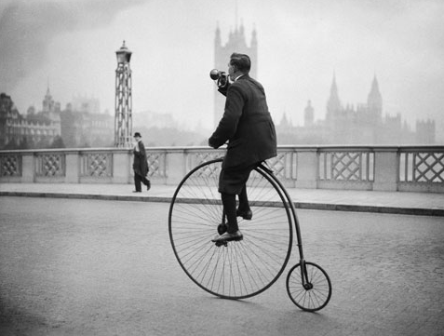
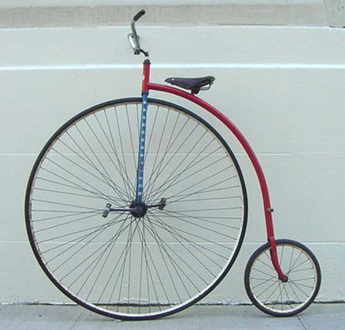
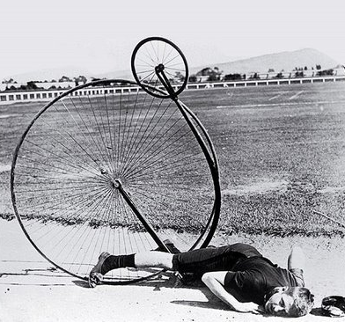
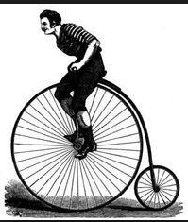
The High Wheeled bicycle has a nickname, do you know what it is?
It was very easy to fall off! Can you think why?
Notes:
In the 1870s, most bike clubs in Britain and the US were rather snobbish affairs - apart from a bike, aspiring novices also needed a uniform and recommendation by a current member. Tradesmen and workers were mostly excluded. Race was also an issue. Initially open to everyone, the League of American Wheelmen officially barred blacks in 1894.

Slide 9
1817 1865 1870 1884
Women found high wheeled bicycles and boneshakers undignified, because in order to ride one they had to lift their skirts.
Some women started to wear trousers, but this was seen as unacceptable.
Trikes were invented, with a seat that allowed women to ride whilst still being dignified.

Slide 10
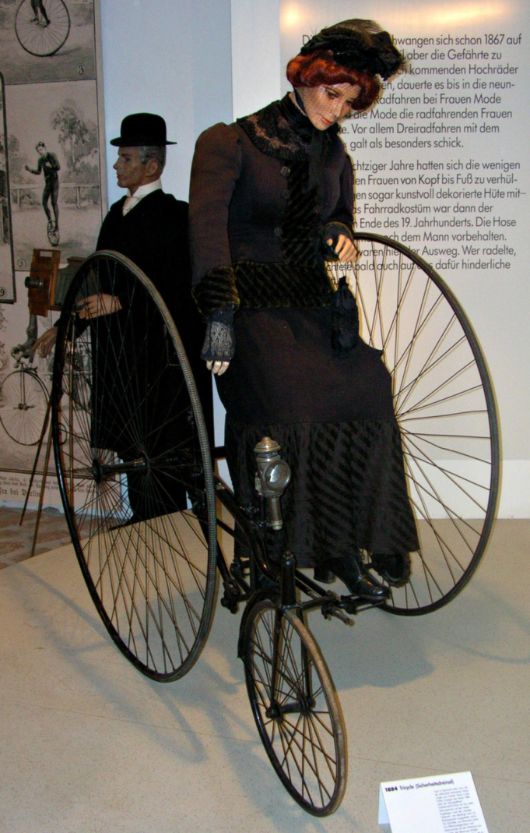
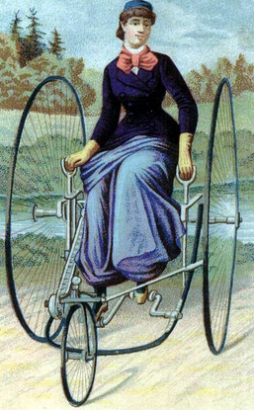
A trike for women 1880s
http://www.crazyguyonabike.com/doc/page/pic/?o=1&pic_id=120249&size=large&v=FM

Slide 11
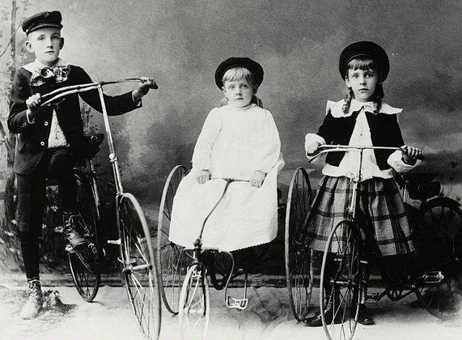
Girls used Tricycles too
What differences can you spot between the girls trikes and the boy’s bicycle?

Slide 12
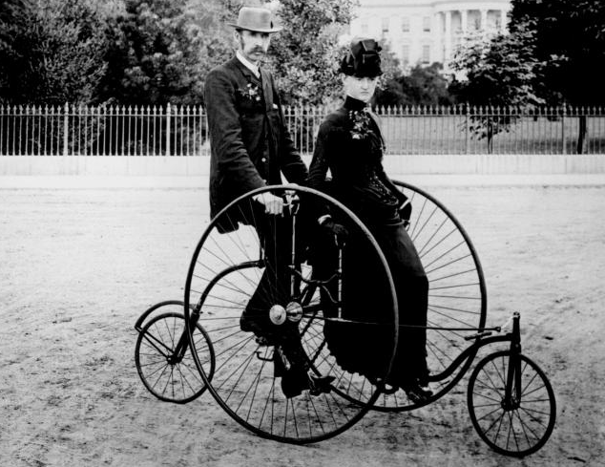
Quad bikes and Tandems
The first quad bikes were designed for wealthy families in the 1880s
Bikes made for two (tandems) were known as ‘Sociables’.

Slide 13
1817 1865 1870 1880s 1885
Penny Farthing (High Wheels) were very unsafe, so inventors came up with a new kind of bike, known as ‘Safeties’
In 1885 The Rover was invented in England. It looked very much like a modern bike today.
Both wheels were the same size and a chain was used to place the pedals in the middle of the frame.
Notes:
The Rover: 1885 - The modern bicycle born in England
The penny farthing was a clear case of a new technology going in the wrong direction - dangerous, impractical, and - in the days of a very strict dress code - unridable for the female half of mankind. One might argue that the penny farthing fad delayed the breakthrough of more sensible designs by more than a decade. Ordinaries ruled the roads until around 1890 before they were finally replaced by the bike as we know it today.One interesting aspect is that penny farthings became popular despite the fact that a better design already existed. The French watchmaker Andre Guilmet had come up with the idea to mount the cranks below the frame and connect them to the rear wheel by means of a chain in the late 1860s. This progenitor of the modern bike already featured equal-size wheels, but failed in the marketplace. For obvious reasons, chain-driven bikes soon became known as safety bicycles. Early safety bikes were often high wheelers with a smaller front wheel.

Slide 14
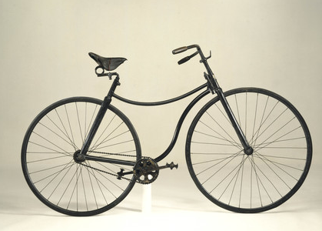
The Rover 1885
Notes:
The Rover inspired a golden age of cycling, and by the end of the 19th century a bicycle craze held both Europe and the United States firmly in its grip. By the mid-1890s, in the US alone some 300 firms produced a million bicycles annually, and the League of American Wheelmen had more than 100,000 members. The American boom was short-lived, though. Demand in the US collapsed after 1898, and numerous firms folded. In the US, bicycles have mostly been used as recreational vehicles ever since.
In Europe, however, the bike remained the most common vehicle until the late 1950s, when the car finally took over. Like many other early bike manufacturers, the Rover Cycle Company had long before become a carmaker, Opel (Germany) and Peugeot (France) being two other well-known examples.

Slide 15
1817 1865 1870 1880s 1885 1894
Elite cycling clubs began appearing in the UK and the US in the 1880s.
They were only for rich people.
In I894 the ‘League of American Wheelmen’ officially banned black people from being able to join.

Slide 16
Bikes in the 20th Century
Bicycle frames have basically stayed the same for over 125 years now
The main changes were in the materials used:
Lightweight metals such as aluminium began to be used
Bikes began to be adapted for different purposes, such as…
Road bikes, racing bikes, mountain bikes, stunt bikes (like BMX)

Slide 17
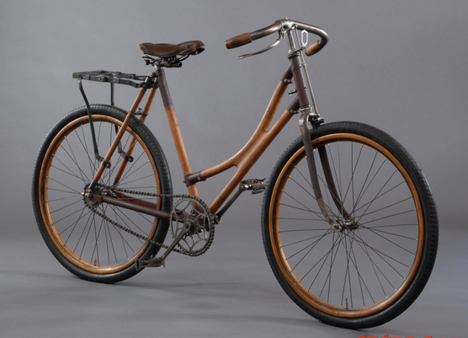
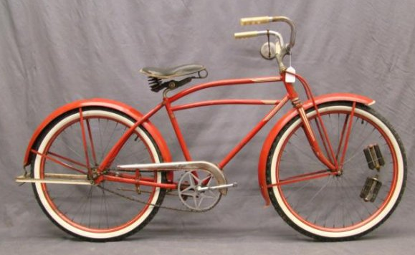
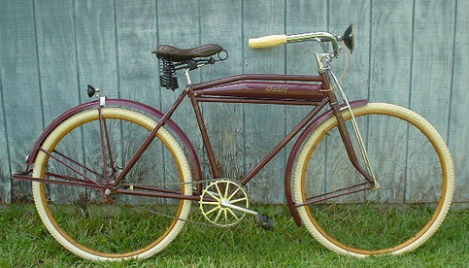
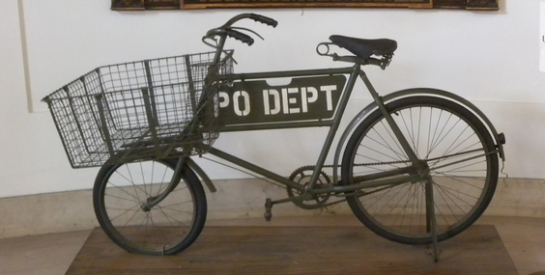
1910s
1930s
1920s
1940s

Slide 18
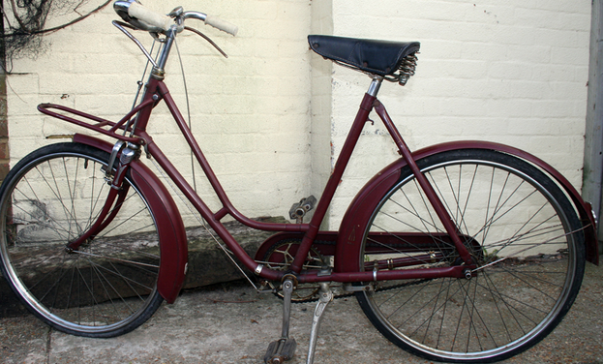
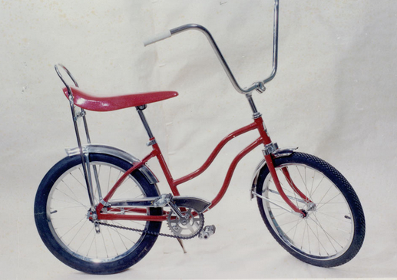
1950s
What is different about the Chopper compared to the other bikes in the 20th Century so far?
1960s The Chopper
Parents weren’t keen on Chopper bikes, making them really popular with teenagers!

Slide 19
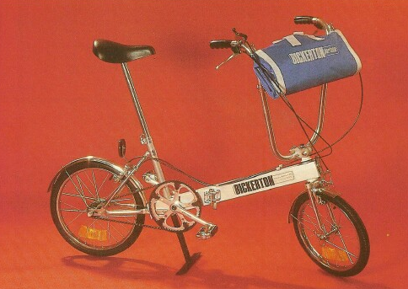
In the 1970s Folding Bikes became very popular.
Why might a folding bike be a good idea?

Slide 20
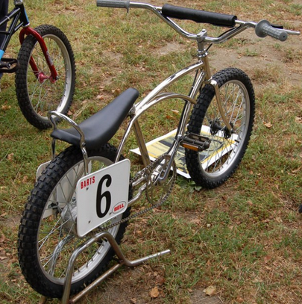
BMX bicycles began in the 1970s
Used for racing and doing ‘tricks’ these remain very popular

Slide 21
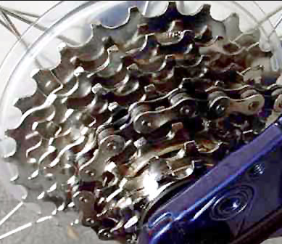
Adding Gears to Bikes became popular in the 1980s

Slide 22
Bicycle of the Future…
So much has changed since those early walking machines. What will bikes be like in another 200 years?
Design a bike of the future. Draw a picture of your bike and label it. Then write a persuasive advert to encourage the people of the future to buy your bicycle.

