Slide 1






Slide 2
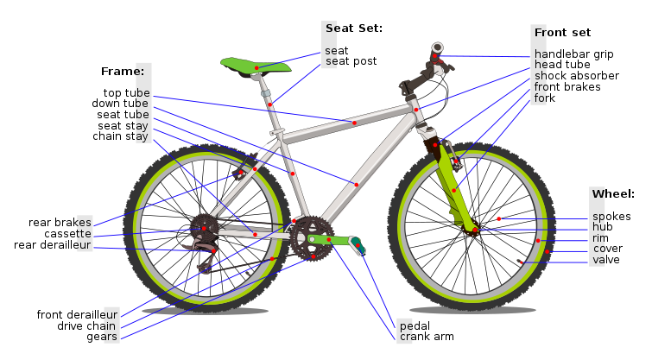
LESSON 6 –BICYCLEs

Slide 3
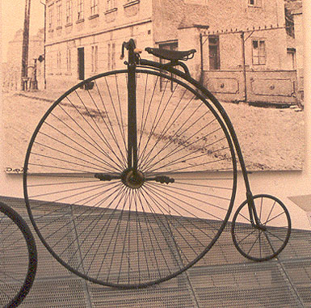
“Penny farthing”
This early bicycle had a steel frame.

Slide 4
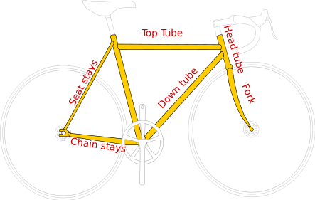
A modern bicycle
A modern bicycle has a frame made of
steel or aluminium or titanium or carbon-fibre

Slide 5
Group work task
Which bicycle is best?
Read the cards to each other.
Sort them into groups.
Use the information to decide which bicycle
you would buy – be prepared to explain why.

Slide 6
Bicycle frames – which would you choose?
Bicycle | Expense | Material | Density | Corrosion | Advantages
Jupiter Trailblazer | £79.99 | Steel | ttttt | llll | Steel is relatively cheap
Shockwave XT 920 | £129.99 | Aluminium alloy | tt | ll | Aluminium is light-weight
Voodoo D-jab | £1499.99 | Titanium | ttt | l | Titanium is very strong
Carrera XC Titan 08 | £899.99 | Carbon-fibre | t | l | Carbon-fibre is light weight and strong

Slide 7
Which metal is best?
Metal | Used for… | Good points | Bad points
Aluminium
Titanium
Steel

Slide 8
Steel – Aluminium – Titanium
Why are aluminium and titanium more
expensive than steel?

Slide 9
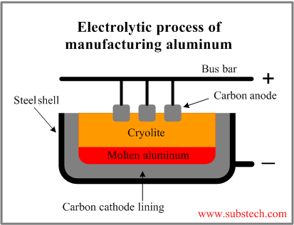
Aluminium is expensive to extract from its ore.
The electrolysis must run 24 hours a day, using massive amounts of electricity and heat.

Slide 10
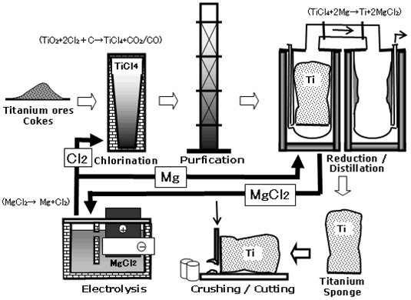
There are many steps in the extraction of titanium from it’s ore – including the extraction of magnesium by electrolysis!
Then you have to do displacement using the magnesium.
Each step requires a lot of energy – which costs money…

Slide 11
Extracting aluminium and titanium
Why is aluminium more expensive than steel?
Why is titanium so expensive?

Slide 12
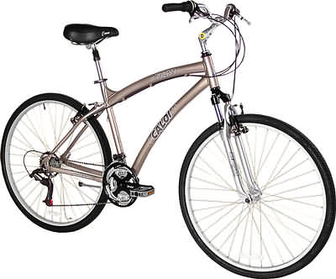
2000 AD
We use aluminium and titanium for bicycles…

Slide 13
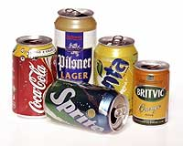
2000 AD
…and drinks cans

Slide 14
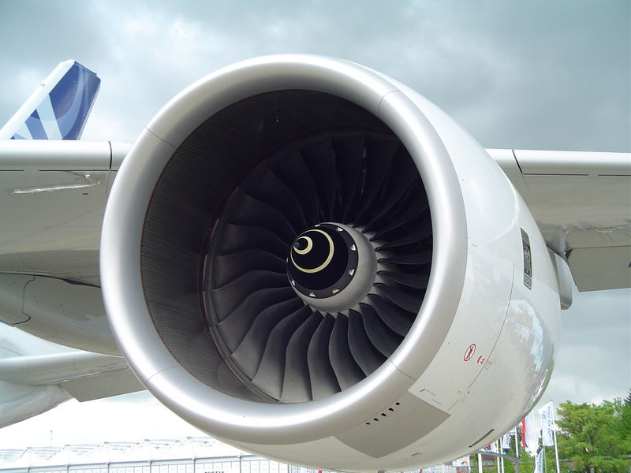
2000 AD
Titanium for planes and space shuttles…

Slide 15
Aluminium is used for drinks cans and bicycle frames because....
Titanium is used for jet engines in aeroplanes and space shuttles because….

Slide 16
Aluminium is used for drinks cans and bicycle frames because it is light-weight and non-corrosive.
Titanium is used for jet engines in aeroplanes and space shuttles because it is lightweight and very strong.

Slide 17
Extracting aluminium and titanium
Why is aluminium more expensive than steel?
Why is titanium so expensive?
What are the useful properties of aluminium and titanium?

Slide 18
SUMMARY
Extraction of aluminium and titanium is expensive because there are many stages in the processes and much energy is needed.
Aluminium and titanium are useful because they have a lower density than other metals and they are resistant to corrosion.

